Slide 1

Energy Production Prediction
Team Members
1. Manpreet Banja
2. Vaishnavi N
3. Vaibhav Hindia
4. Ankit Yadav
5. Megha SK
6. Sushrutha UK
Mentor Name : Neha Ramchandani
Date : 05/07/2022

Slide 2
Business Problem:
A combined-cycle power plant comprises gas turbines, steam turbines, and heat recovery steam generators. In this type of plant, the electricity is generated by gas and steam turbines combined in one cycle. Then, it is transferred from one turbine to another. We have to model the energy generated as a function of exhaust vacuum and ambient variables and use that model to improve the plant's performance.
Objective:

Slide 3
Project Architecture / Project Flow
Collection of Data
Business Understanding
Exploratory Data Analysis(EDA)
Model Building
Deployment

Slide 4
Exploratory Data Analysis (EDA) and
Feature Engineering

Slide 5
Data set details
The data file contains 9568 observations.
It as five variables collected from a combined cycle power plant
over six years.
The variables, are the following:
1. temperature, in degrees Celsius.
2. exhaust_vacuum, in cm Hg.
3. amb_pressure, in millibar. (Ambient pressure)
4.r_humidity, in percentage. (Relative humidity)
5.energy_production, in MW, net hourly electrical energy
output.

Slide 6
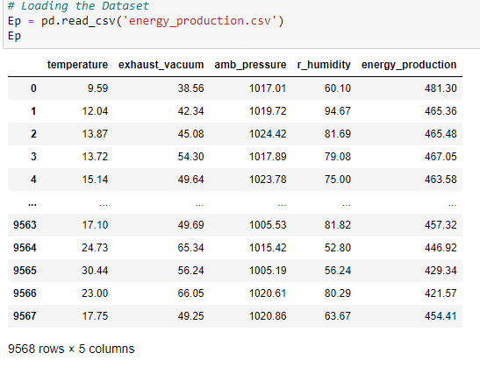
Exploratory Data Analysis (EDA)

Slide 7
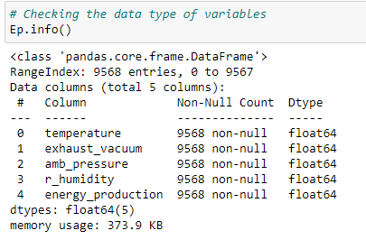

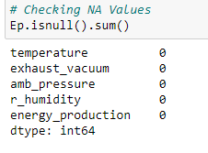

Slide 8
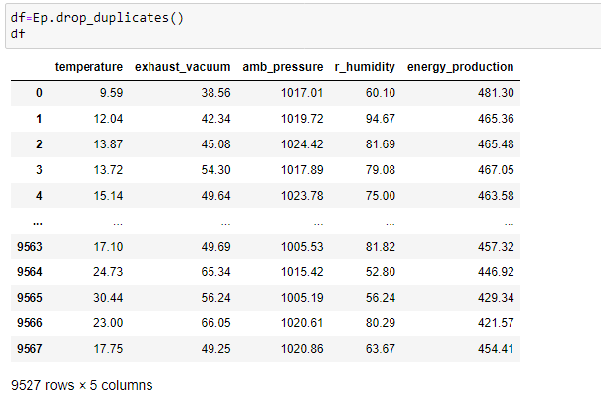

Checking Duplicate Values

Slide 9
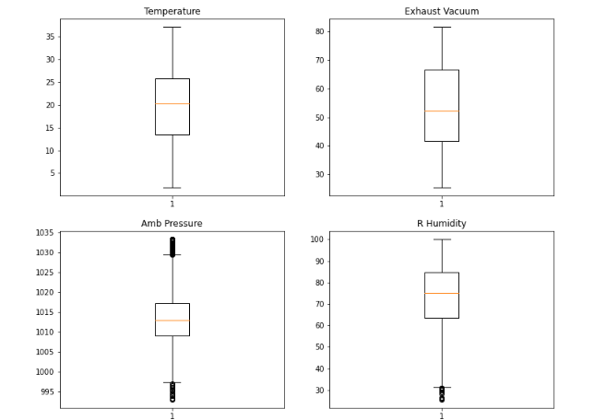
Visualizations:
Checking for Outliers using Boxplot

Slide 10
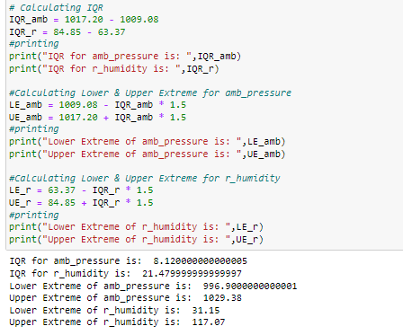
Removing outliers using IQR method:

Slide 11
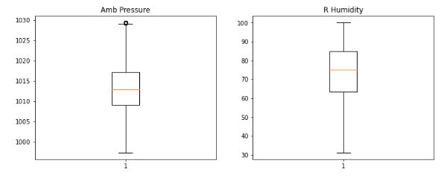
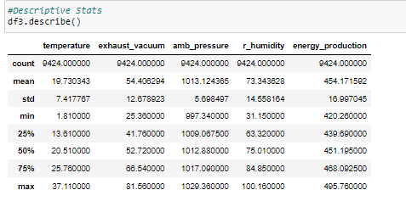

Slide 12
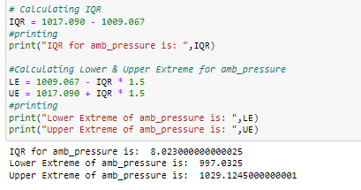
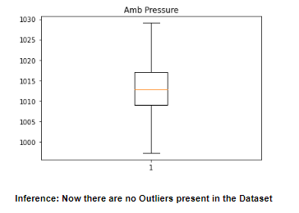

Slide 13
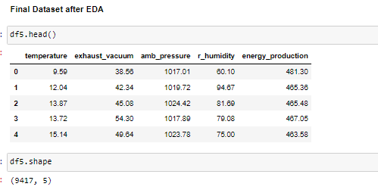
EDA

Slide 14
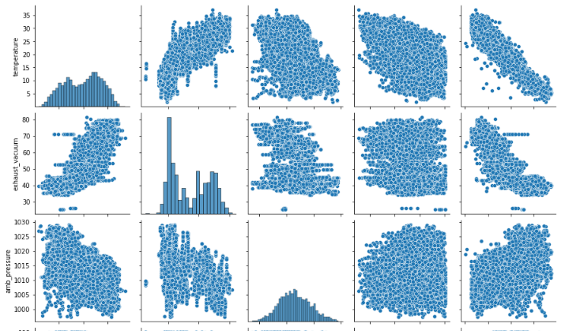
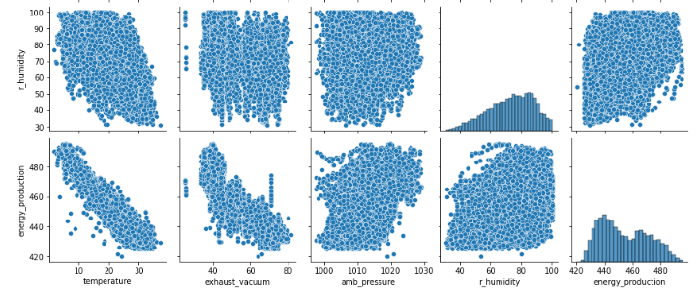
Detecting Collinearity B/W independent variables

Slide 15
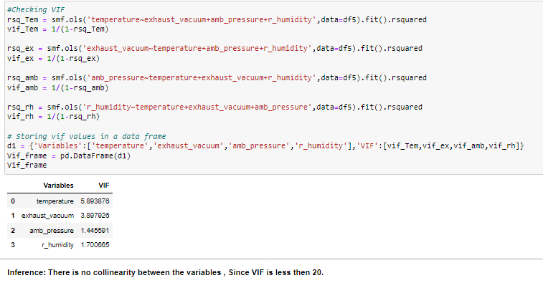
Cross-Check with VIF

Slide 16
Model Building

Slide 17
Models Used For Model Building :
Linear Regression
Lasso & Ridge Regrission
Dession Tree Regression
Random Forset Regression
Adaboost Regressor
KNN Model
XGBoost Regressor

Slide 18
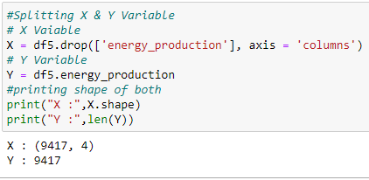
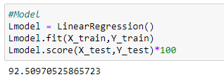
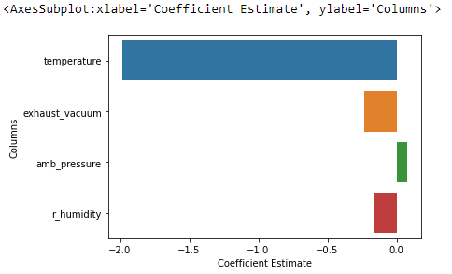
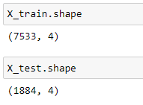
Splitting X and Y
Linear model

Slide 19
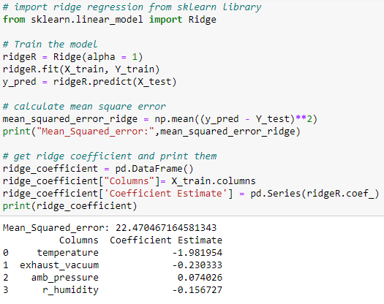
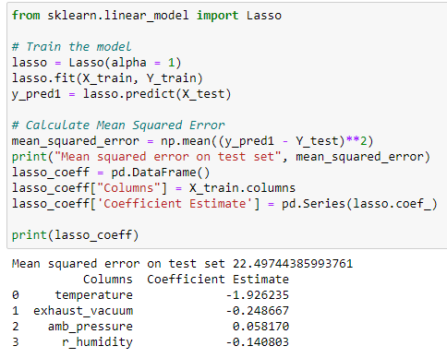
Lasso and Ridge Regression

Slide 20
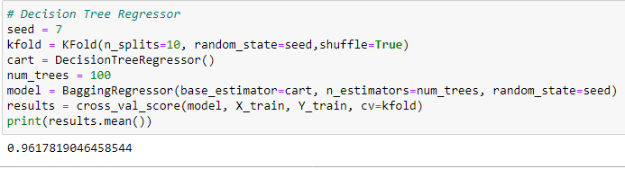
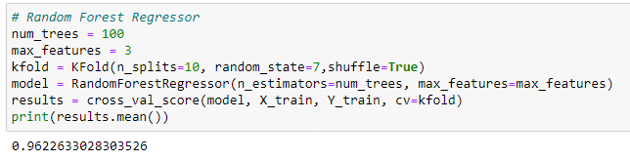
Decision Tree Regressor
Random Forest Regressor

Slide 21
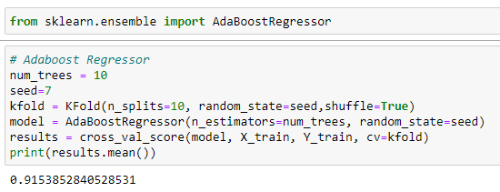

Adaboost Regressor
XGBoost Regressor

Slide 22
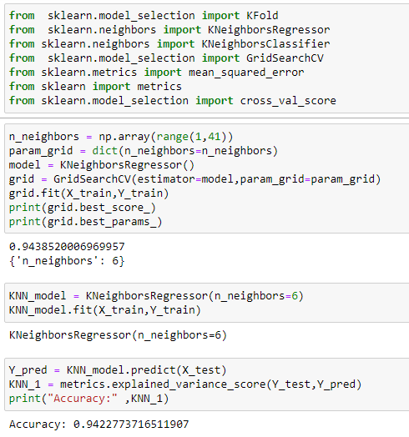
KNN Model

Slide 23
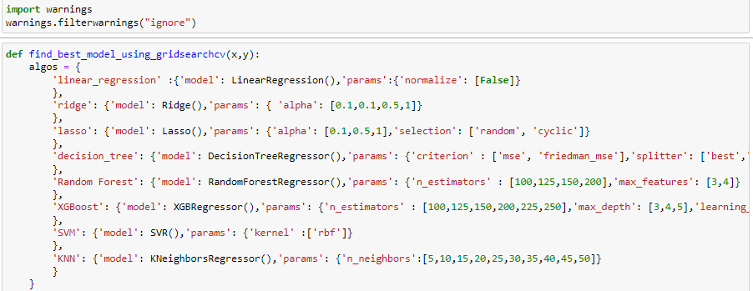
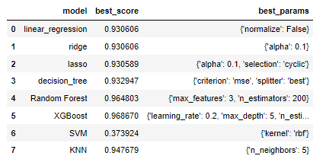
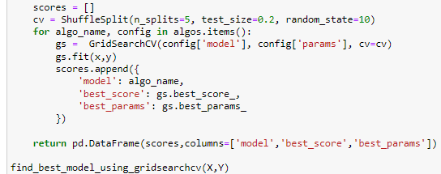
Choosing the best model

Slide 24
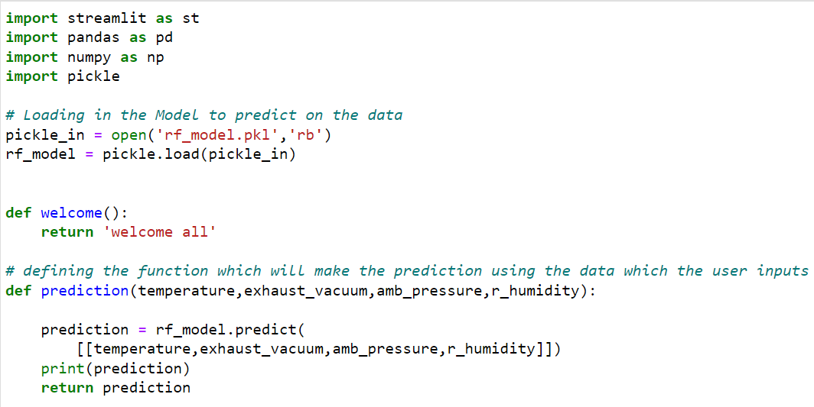
DEPLOYMENT

Slide 25
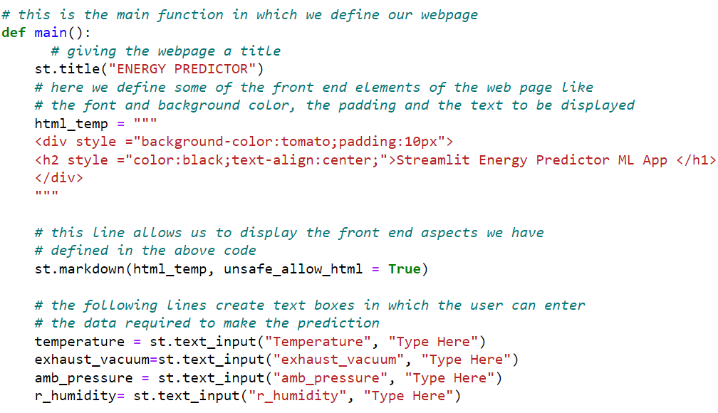
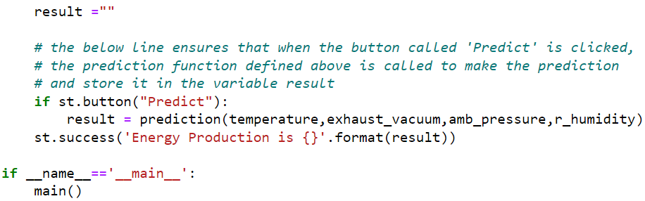

Slide 26
Thank you

